Slide 1
1 Planed
Planed 1
Solve the problem in this slides
Finish the study of week04(this week finish the study of Assembly Basic)
Finish the Quiz1 and Assignment3
4

Slide 2
1 Results
Results 1
Be confused about how to do the quiz1.
4

Slide 3
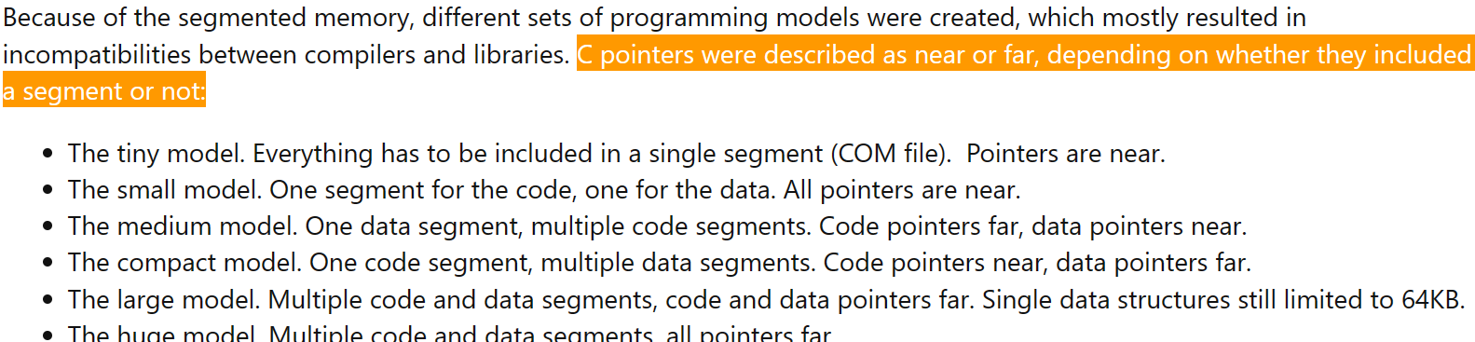
1 Challenges and Solutions
Challenges and solutions 1
About the far point and the near pointer.
C pointers were described as near or far, depending on whether they included a segment or not:
I know how to judge a C pointer , but why? Can an assemble program contain multiple data segments or code segments?
4

Slide 4
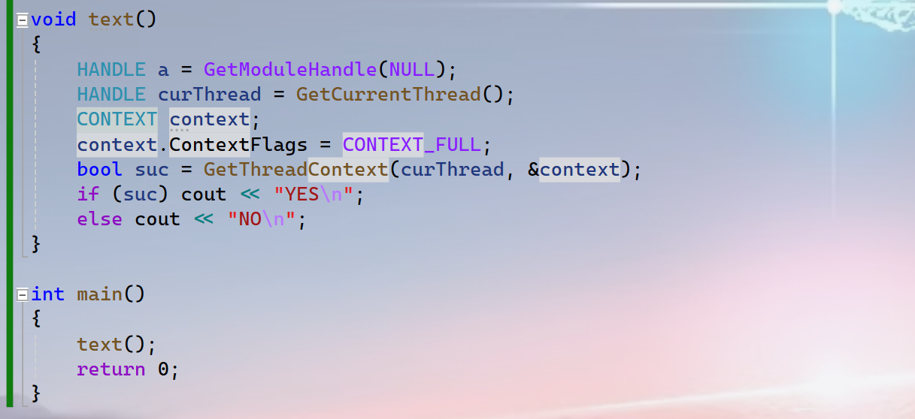
1 Challenges and Solutions
Challenges and solutions 1
The value at the [Rdx + 0x10] is not the image base of the program.
I wonder how does he know that?
I guess the thread context , got by the API `GetTHreadContext` , is different between suspended thread and current thread?
4

Slide 5
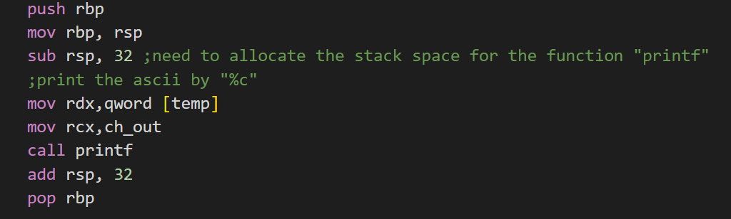
1 Challenges and Solutions
Challenges and solutions 1
Why I need to allocate the stack space for the function “printf”? And what does this space use? To store the parameter passed to the function?
The function will deal with the stack itself ?
4

Slide 6
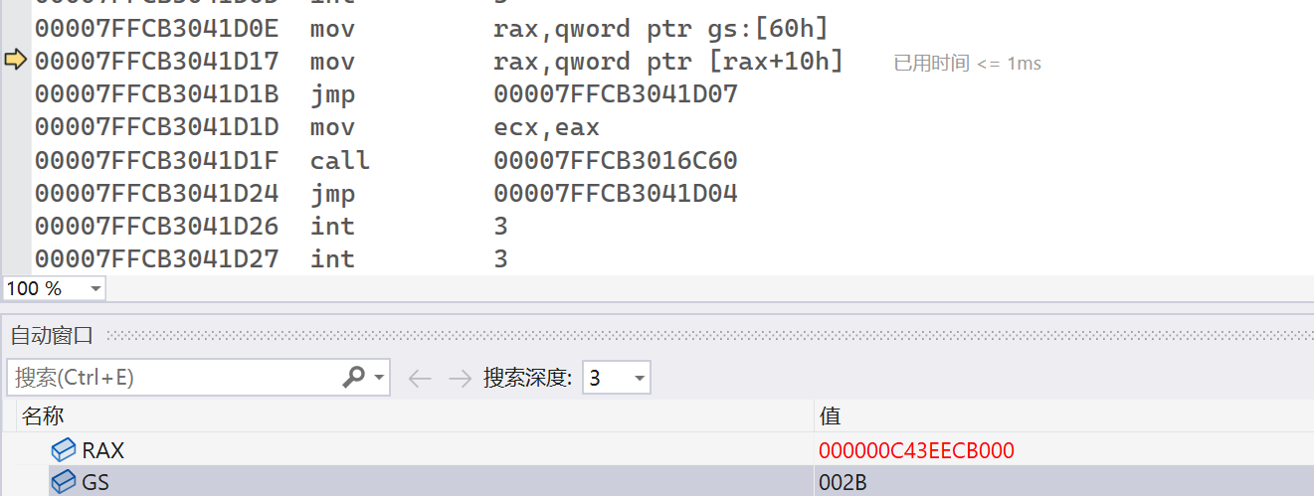
1 Challenges and Solutions
Challenges and solutions 1
In real mode, the address of “gs:[60h]” follows the format “segment : offset. The real address of it is segment * 0x10 + offset.
But I can not get the real value of GS by this way.
4

Slide 7
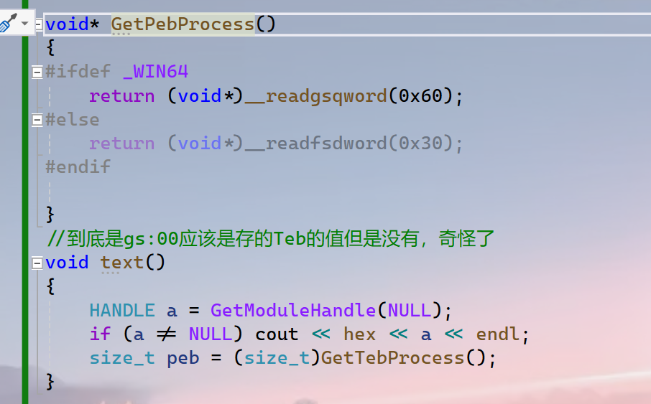
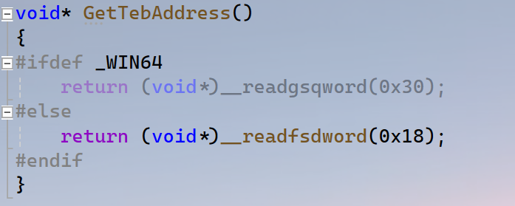
1 Challenges and Solutions
Challenges and solutions 1
__readgsqword(0x0) the return value of it is zero why?
I think the value stored in the GS, is the address of TEB, but I found it is the zero.
4

Slide 8
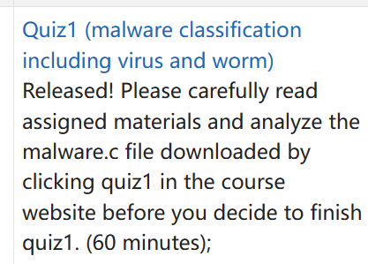
1 Challenges and Solutions
Challenges and solutions 1
I have no idea how to do that. I do not know how to analyze the malware.c file. 😔
4

Slide 9

1 Challenges and Solutions
Challenges and solutions 1
Emmm…do you have a free one? 😔
4

Slide 10
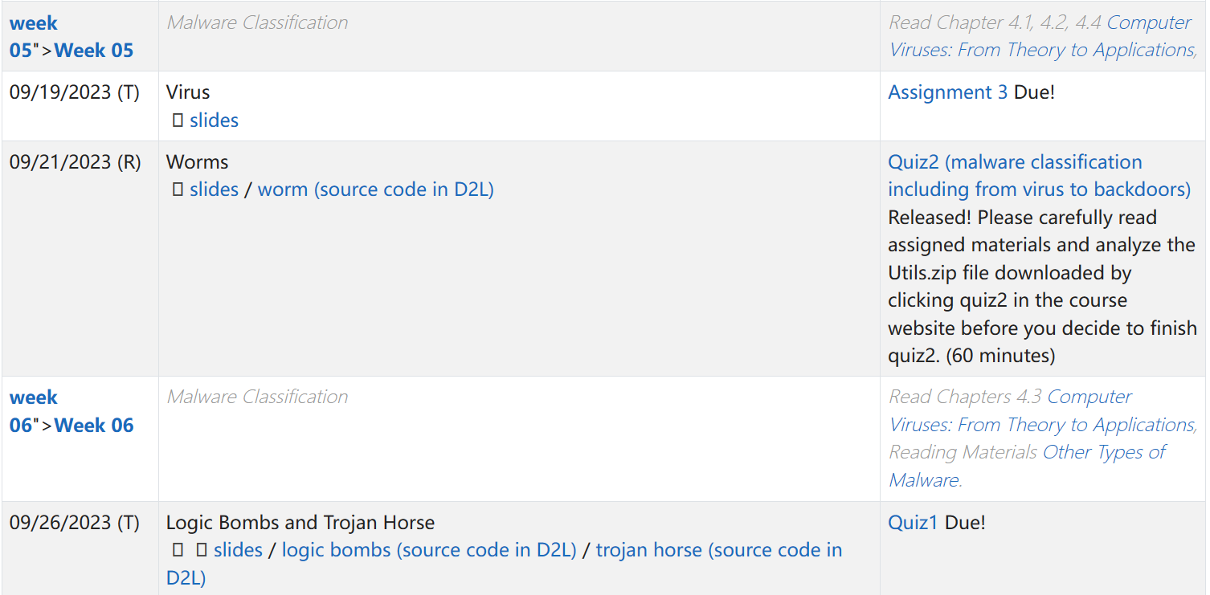
1 Plan
plan 1
Study task: week05 to quiz1 Due
Write a blog mainly about how to get the Teb and Peb.
4

